Slide 1










SOCIETY MANAGEMENT SYSTEM
SUBMITTED TO – PROF. Sonal Mehrotra
SUBMITTED BY–
Abubakar Mobin Ahmed Vishal R Choudhary Mansi S Awaghade

Slide 2

INTRODUCTION
Todays modern society needs much modern solution for its proper management, which can replace human efforts. Any co-operative society or housing society need a hassle free and efficient society management system for managing its day-to-day work. Other than that this system is not only to deal its complaints but has to keep eye on all other facility and activities under the society premises. Thus taking help of society management system website makes it easier and more covenant to the users.

Slide 3
Aim of the Project
In current situations, housing society management authorities use a traditional way of communication which
includes a common notice board system operated by responsible society members. Through an online web
portal, it provides society members to easily interact with each other avoiding physical presence. Most of the
options are available through an online web portal which will be easier and convenient for the society members
as well as visitors.

Slide 4








TECHNOLOGIES USED -
Tools / Platforms | Visual Studio Code
Programming Languages | Html, Css, JavaScript, PHP
Database | MySQL Database

Slide 5
HOME PAGE OF THE WEBSITE

Slide 6
Home page includes-
Admin-
Admin is directed to admin login page where admin can login.
Users-
Users are directed to user login page where users can login.
Rent/sell-
Viewers/ Guest can check the Rent or Sell list updated by the Users.
Testimonials –
Reviews regarding the society are displayed over here.
Contact us-
Viewers or guest can contact through this for any query.

Slide 7
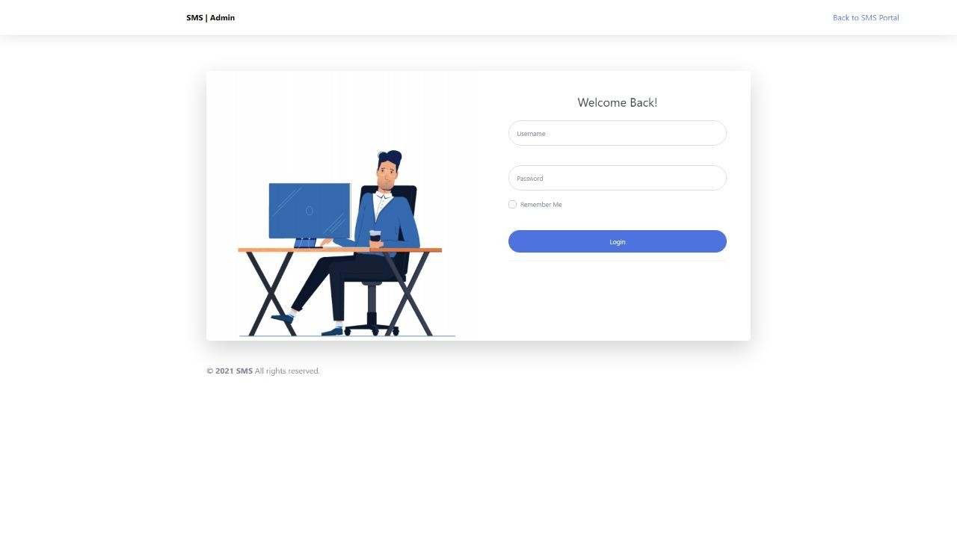
Admin login page-
Admin can login from this page by entering correct password and username. After logging in the admin dashboard page is been displayed.

Slide 8
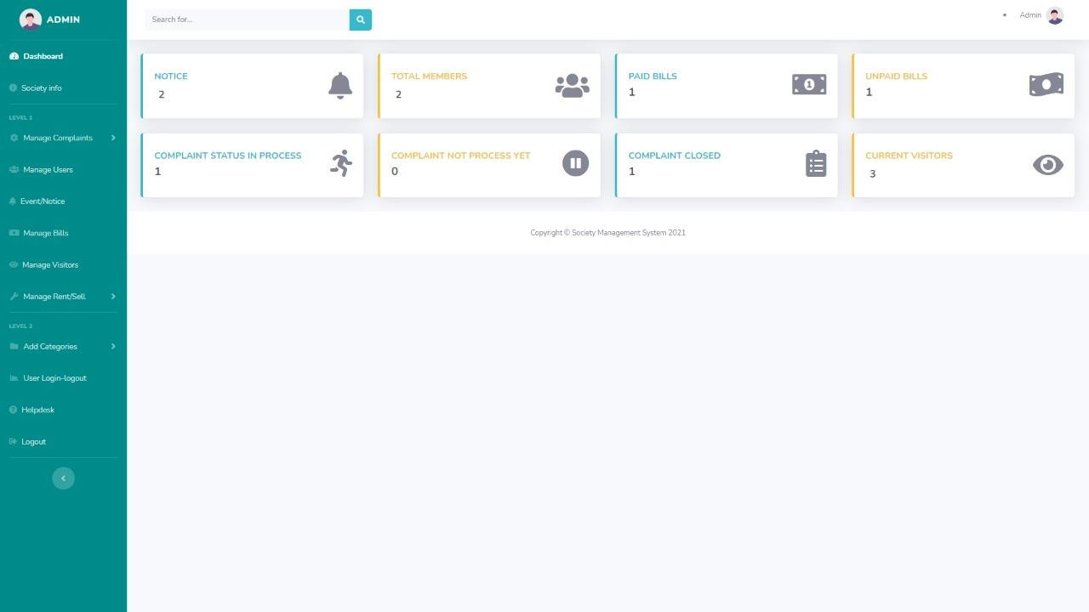

Slide 9
Admin dashboard page –
After successfully logging in the admin dashboard it has modules like-
1)Society info-
Here admin can add information's about the society like
Society name
Owners name
Official email of the society
Contact number of the society.
Count of Existing members in the society
Along with the full address of the society
Total number of flats in the society
Admin can also update and change the required details of the society from this page.
2)Manage complaints-
Here all kind of complaints are resolved and viewed by the admin raised by the users.
The complaints are segregated in to 3 types of modules-
Not processed yet complaints- in this admin can see the complaints which is not been resolved by the him.
Pending complaints- here admin can check complaints which are raised by the Users recently and yet to be solved.
Closed complaints- in this admin can view the complaints which are resolved by him.

Slide 10
3)Manage users-
Here admin can view the details of the members of society like-
Full name
Email of the member
Contact number
Status of the member and can DELETE the details only.
4)Event/notice-
Admin can create notice or important feeds of the society and can update the feeds. Admin can also check the previous notice along with that he can edit or delete the notices previously updated.
5)Manage bills-
For sending the bills of any kind admin can do it from here. Admin can select particular user and send him bill
Light bill
Water bill
Maintenance bills
He can also check weather the previous bill is been paid by the user and can edit
Or delete the bills from this page.

Slide 11
6)Manage Visitors-
Here the numbers of visitors can be checked by the admin it has-
Visitors residential address
Contact numbers
Reason of meeting
And the person of meeting
Other than this admin can manage the list of visitors.
7)Manage Rent/Sell-
It has 2 modules in it-
Rent/Sell List- in this admin can only VIEW the list updated by the users which is for Sell or Rent.
Manage Clients- Admin can only VIEW the Clients Details Requested for the services by the Users regarding the Flat Rent/Sell.
8)Add Categories-
It has 3 modules –
Add Categories- in this admin can add the TYPE OF ISSUES faced by the user and can also manage them.
Add Subcategories- here admin can add the SUBCATEGORY OF THE ISSUES faced by the user and can also manage them.

Slide 12
Add State- here admin have to save the city or state name for easy segregation of the issues faced by the users.
9)User Login-Logout-
Here admin can check the status of the users LOGIN-LOGOUT timings along with the USER IP.
10)Helpdesk-
Every kind of help line numbers and details are updated and added here for the emergency use of the users like
Official email of the society
Secretary number
Security guard number
Nearest hospitals ambulance numbers
Police Stations number
Firebregade number
Apart from this admin can update or delete the numbers accordingly.
11)Profile-
Admin can change his/her password from here.
12)Logout-
Admin can logout from here to exit the Admin Dashboard Page.

Slide 13
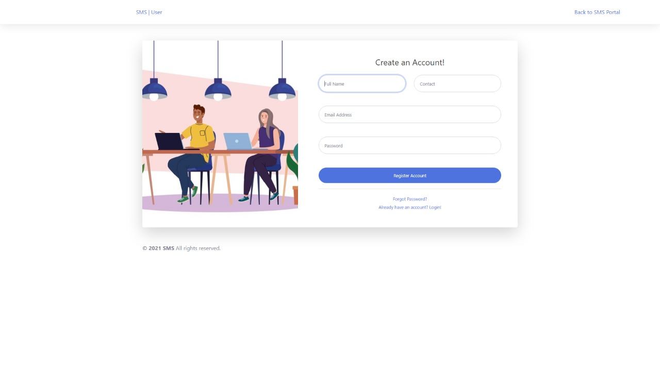

Slide 14
User Create Account
New user can register himself from this page. It takes details like-
User’s Full Name
Contact Number
Email Address
Password
After providing this details the user can register and log on from user dashboard page by entering correct email address and password.

Slide 15
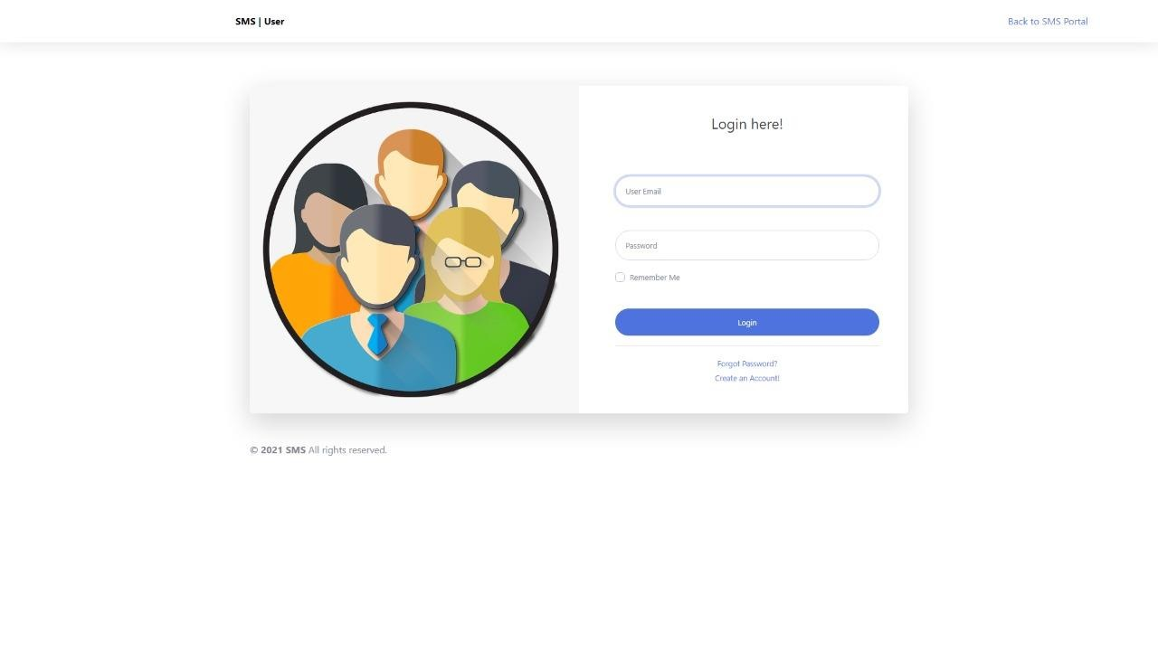
User login page-
Existing user can login here with correct username and password to login in user dashboard page .

Slide 16
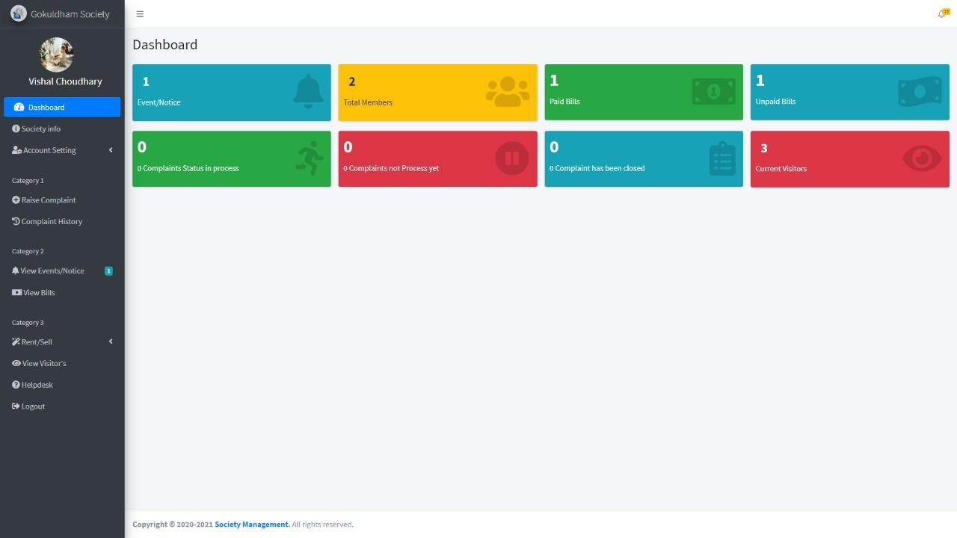

Slide 17
User dashboard page –
After successfully logging in the user dashboard it has
1)Society info –
Here user can view the details updated by admin regarding the society.
2)Account settings-
Edit profile-
User can update and change his/her personal details like
Name
email id
Address
flat no
Flat type
along with his/her profile photo.
Change password-
Here user can change his password .
3)Raise complaint-
User can raise the complaint form here, issue faced by him which will be getting resolved by the admin.

Slide 18
4)Complaint history –
User can check the existing as well as current complaints and check the resolution provided by the admin.
5)View bills-
Users can view and pay the bill online which is been generated admin. Users can also download the bills .
6)Rent/sell- a)Add rent-
User can add his/her flat for rent by giving details like
Flat number
Flat Rent
Deposit
Flat type
And can update the existing list of flat for rent .
b)Add sell-
Here user can sell his/her flats by giving details like
Flat type
Flat price
Flat number
And can update the existing details .

Slide 19
c)Manage clients-
Here user can manage and view the entries done by the visitors interested in flat Rent/sell purpose along with the user .
7)View visitors-
Users can view the visitors list which includes visitor’s –
Name
Address
Contact number
Date
Time
Reason to meet
Person of meeting
In and out time

Slide 20
8)Help Desk-
Every important details is been provided by the admin is here like-
Society email id
Secretory number
Electrician number
Ambulance number
Fire brigade number
Police number
9)Logout
User can logout from here to exit from User Dashboard Page.

